Slide 1


E15 Outboard Marine High Ethanol Fuel Endurance
A study of the effects of running gasoline with 15% ethanol concentration in current production outboard four-stroke marine engines and conventional two-stroke outboard marine engines.
Subcontract Report
NREL/SR-5400-52909
October 2011

Slide 2
Overview
Test Objective: Run 300 hours of wide-open throttle (WOT) endurance on 3 engine families.
Two engines from each family: One on E15 (15% ethanol blend fuel) and the other on pure gasoline (E0).
    9.9HP 4-stroke carbureted,
    300HP Supercharged 4-stroke “Verado”,
    200HP 2.5L 2-stroke EFI (represents “legacy” product)
  Engine selection was reviewed and approved by NREL Technical Monitor
Test standards used were common qualification tests.
  Test regimen was reviewed and approved by NREL Technical Monitor

Slide 3
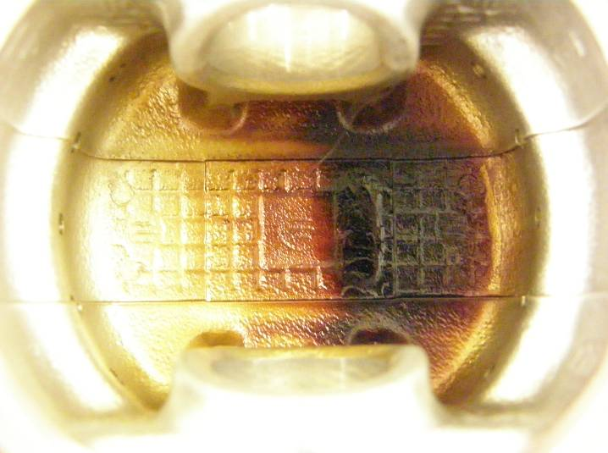
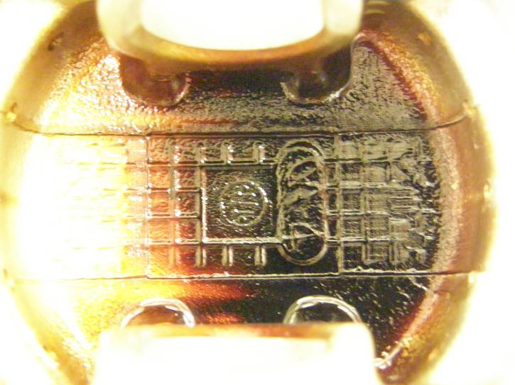
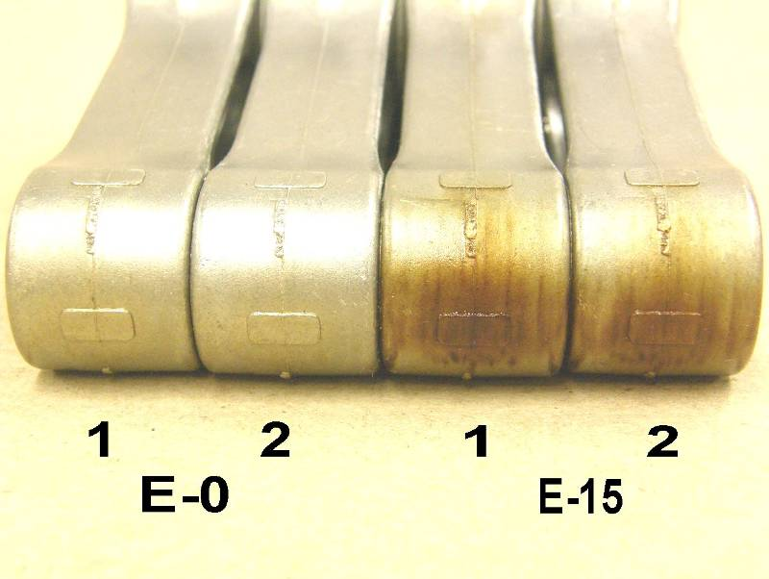
9.9HP Carbureted 4-Stroke
Completed 300 hours testing but showed deteriorated emissions and run quality at end of test
More carbon deposits on piston underside and rods of E15 engine indicating higher temperatures.
E0 Piston
E15
Piston
Connecting Rods

Slide 4
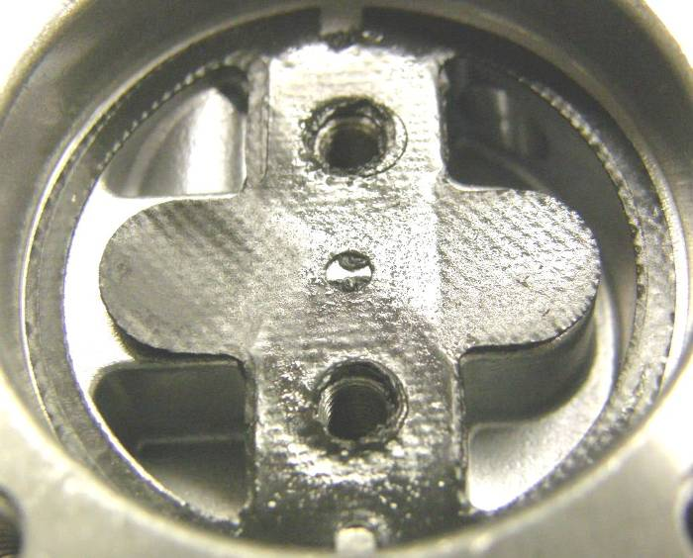
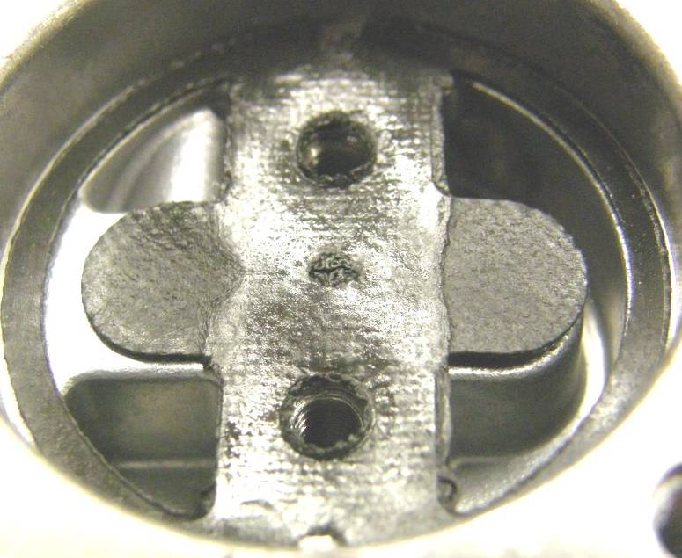
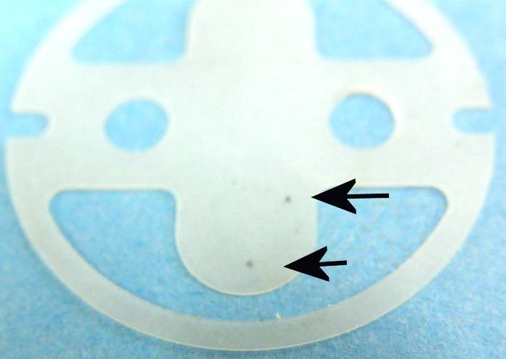
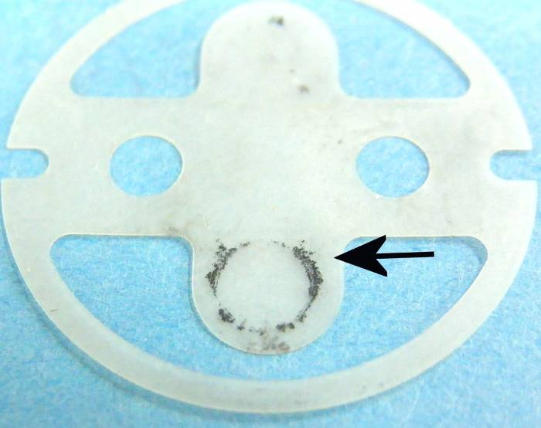
9.9HP Carbureted 4-Stroke
The fuel pump gasket showed signs of deterioration on the E15 engine compared with the E0 engine.
E0
E15
Material transfer from gasket to check valve

Slide 5
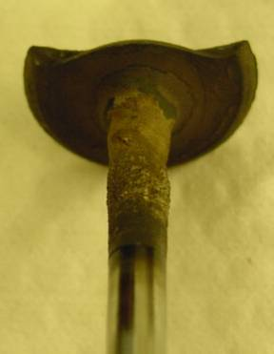
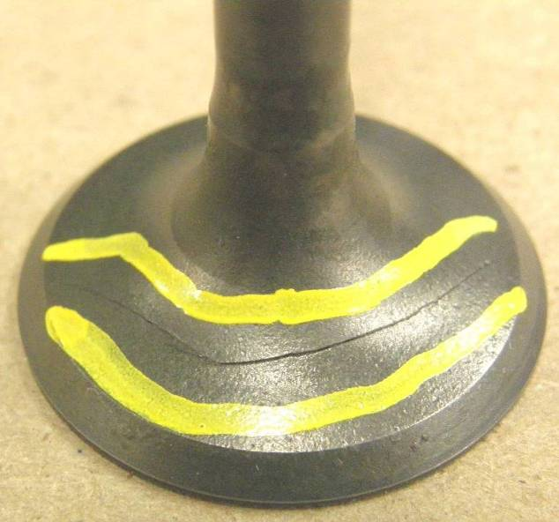
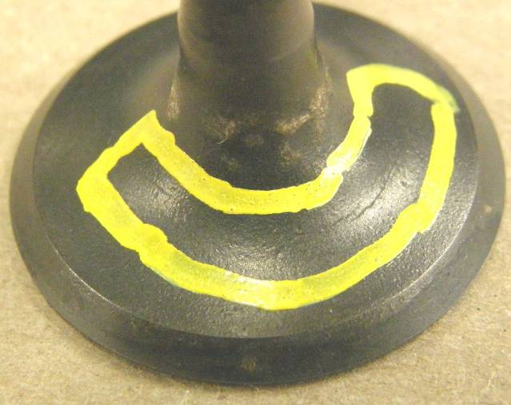
300HP Supercharged 4-Stroke “Verado”
Cylinder 3
Bottom Valve
E15 Exhaust Valve Failures
Cylinder 3
Top Valve
Cylinder 6
Top Valve

Slide 6
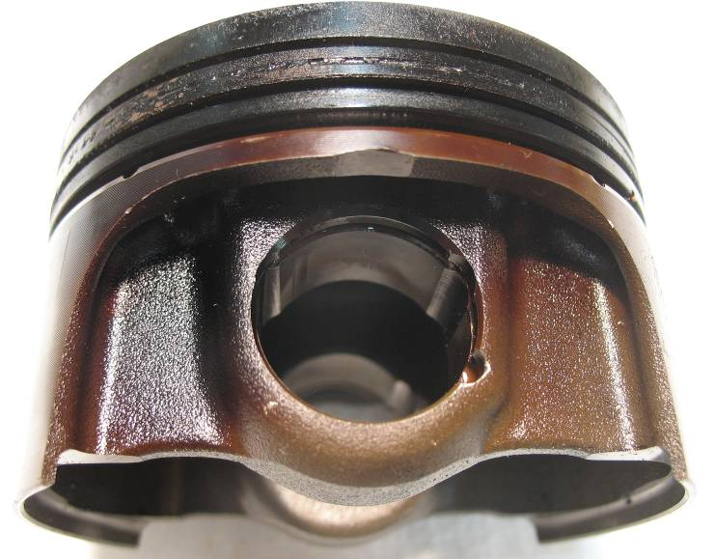
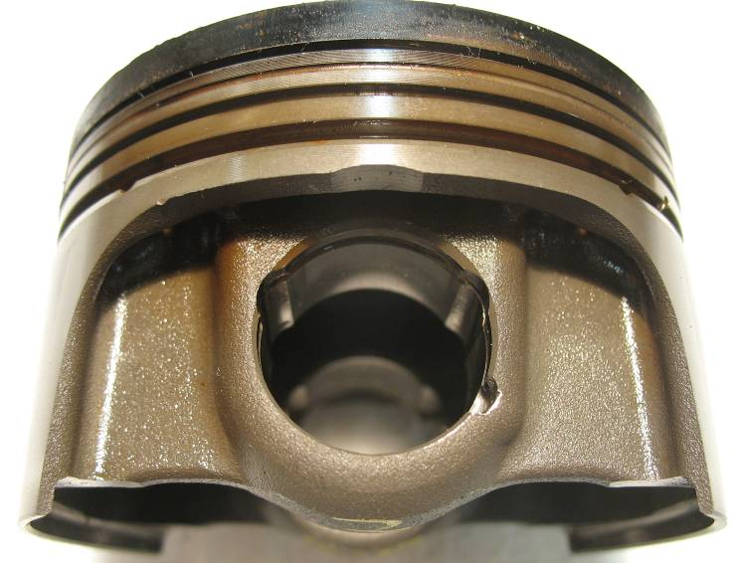
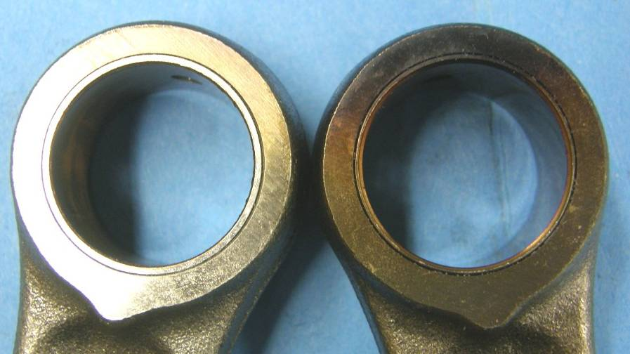
300HP Supercharged 4-Stroke “Verado”
Carbon deposits indicate that the E15 engine’s pistons and connecting rods were hotter during operation than those in the E0 engine.
E0
E15

Slide 7
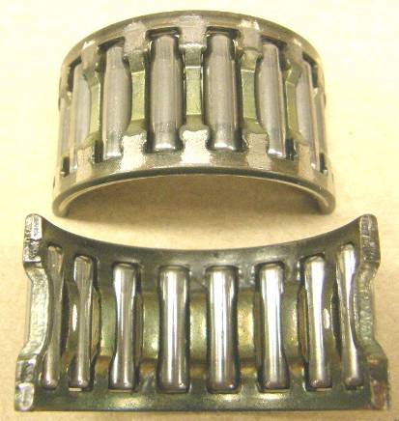
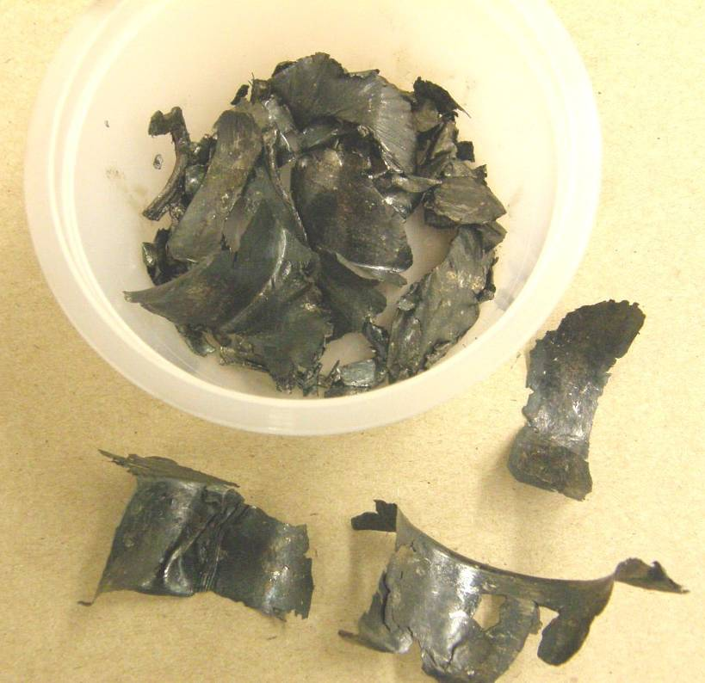
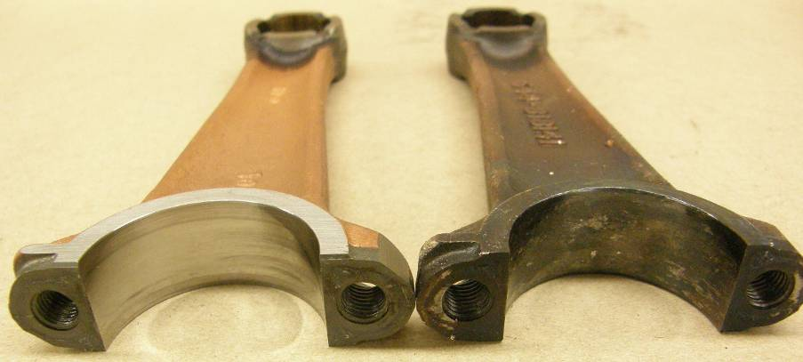
200HP EFI 2.5L 2-Stroke – Failed Endurance Testing
Recovered Pieces from Failed Rod Bearing
Undamaged Bearing
E15 Failure
Undamaged Rod Damaged Rod

